Slide 1
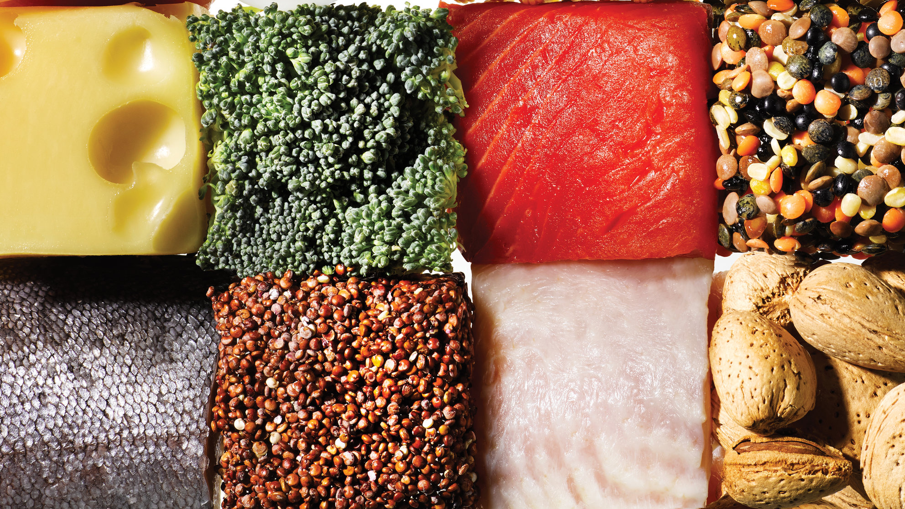
Tailored Nutrition
Sanjeev Sharma, Andrew Glyadchenko, Leon Campbell, Alvin Lam
Advnc apl:cpstne maj CSCI 49900
5-10-18

Slide 2
OUR
VISION
T
N
A Cross Platform Nutritional App
Allow quick and easy logging of food.
Guide users by focusing on their proteins, fats, and carbohydrates.
Find the best nutritional plan to help the user achieve their fitness goal.

Slide 3







Our Story
A
B
C
D
E
Learn / Design
Welcome & Sign In/Sign up
User Profile
NutritionX API
Logging Foods
React Native basics.
Architecture, Wireframing
Various flows
Nutritional API research
Styling of all three screens.
User table creation with various bits of data received on sign up.
User authentication on sign in.
Styling of user profile.
Implementation of tab view to show search tab and log tab.
Calculate and display user nutritional limits.
Figuring out how to query the API for retrieval of macros and calories.
Implementation of barcode scanner.
Storing user food searches into user log table.
Subtracting logged macros from recommended.

Slide 4
What We Learned
How to use various coding-based structures, like React Native, SQLite, and JavaScript.
Switching from using Realm to SQLite as our database of choice, which made storing data a bit easier.
How to make API calls to a database with established info, like NutritionX.
How to create an attractive UI.
Proper usage of platforms like GitHub and Slack as means of organizing our team and distributing work.

Slide 5
What Went Well
Making a presentable UI.
calls to the NutritionX database.
Logging food to the user’s log table from the NutritionX API.
Login and signup pages.
Barcode scanner.

Slide 6
What Didn’t Go Well

Slide 7
TailoredNutrition();

Slide 8
return 0;

